Slide 1


Fuzzy and Cross-App Replay for Smartphone Apps
Yongjian Hu Iulian Neamtiu

Slide 2
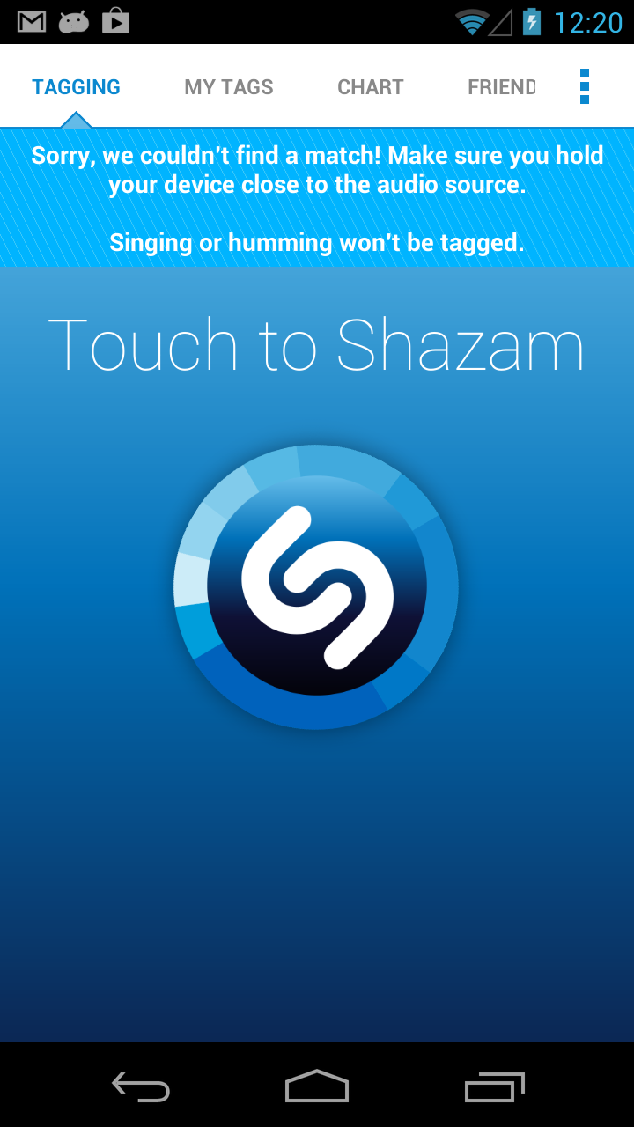
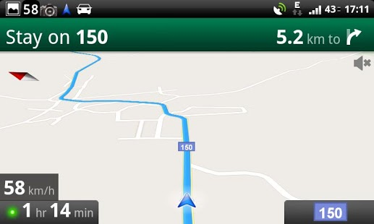
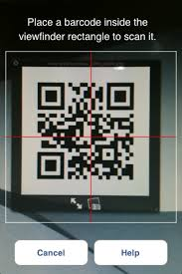

Smartphone applications are sensor driven
Location: Navigation, Location Based Service(LBS), …
Camera: Taking Pictures, Pattern Recognition(e.g., QR code), …
Audio: Voice Message, Music Recognition, …
And more: Motion, Light, Compass, etc
Navigation
Barcode Scanner
Shazam

Slide 3

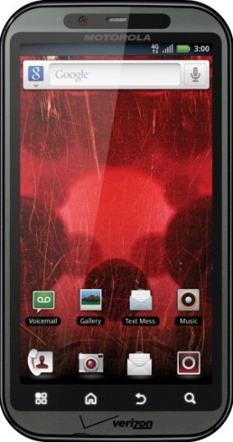
Writing Effective Test Cases Is Hard
Automatic exploration results A³E (Automatic Android App Explorer)
Azim&Neamtiu OOPSLA’13 25 popular free&paid apps (> 1million downloads)
Runs on actual phones, no source code required Coverage 62% screen coverage 33% method coverage
Why not 100% coverage?
pay/purchase activities;
background services;
Low sensor coverage;
User study: 7 users, 28 apps
5 min. runs
LOW Coverage
Limited Coverage
Coverage
Only 30% of the app screens and 6% of the app methods covered!

Slide 4
Writing Test Cases Requires Effort
Waste time to generate multiple test cases for similar apps
Sensor | Apps
Location
Camera
Audio

Slide 5
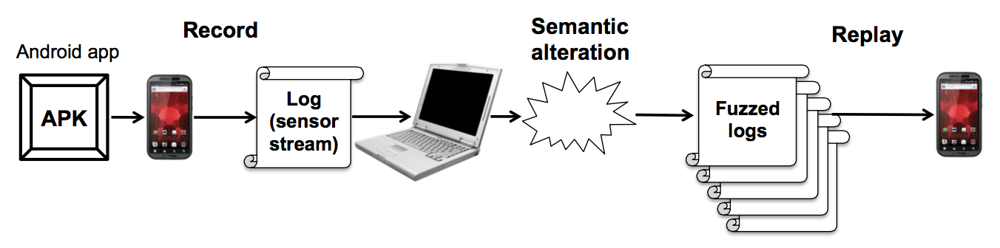
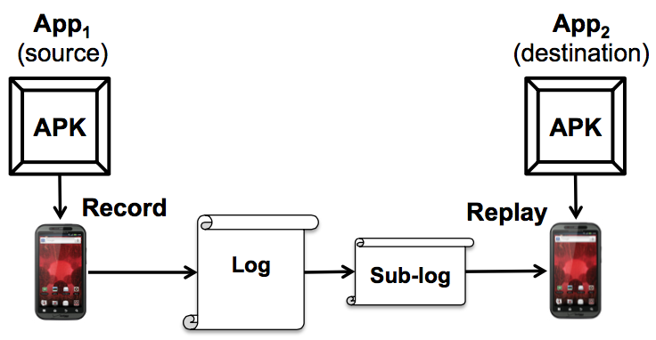
Our work
Expand coverage from existing test cases
Semantic sensor data alteration (SSDA)
We only change inputs, no app source code required
Reuse test cases cross apps

Slide 6

Location SSDA
Change Speed
Shifting Map
Inject Null Location

Slide 7
SSDA Evaluation (Location)
App | Sensor | SSDA | Outcome
Yelp | GPS | Null Reference | CRASH
 |  | Map Shift | Different search result shown
 |  | Speed Change | Normal execution
GPS Navig&Map | GPS | Null Reference | CRASH
 |  | Map Shift | Different map route shown
 |  | Speed Change | Different driving speed shown
Route 66 Map | GPS | Null Reference | CRASH
 |  | Map Shift | Different map route shown
 |  | Speed Change | Different driving speed shown
NavFree | GPS | Null Reference | CRASH
 |  | Map Shift | Altered execution: “unknown coordinates” error message
 |  | Speed Change | Different driving speed shown
GasBuddy | GPS | Null Reference | Altered execution: “Oops! device cannot find your location” error message
 |  | Map Shift | Different search result shown
 |  | Speed Change | Normal execution

Slide 8
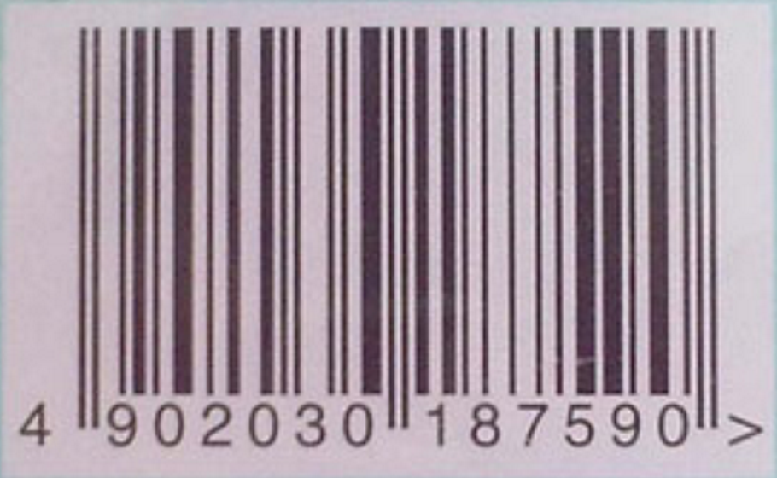
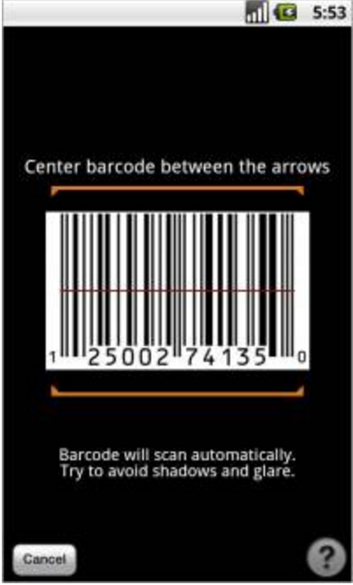
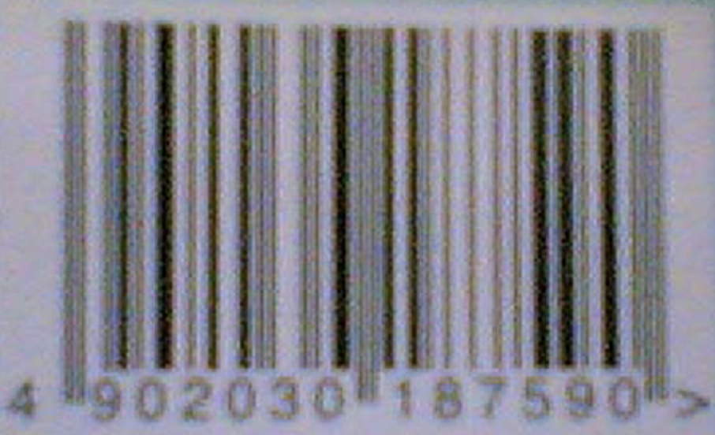
Camera SSDA
Darken
Lighten
Rotate
Blur

Slide 9
SSDA Evaluation (Camera)
App | Sensor | SSDA | Outcome | Coverage Increase (%)
CamCard HD Free | Camera | Blur | Altered execution: fail to recognize picture | 2
 |  | Darken | Altered execution: “Low Light” error message | 2
 |  | Lighten | Altered execution: “Blurry Image” error mes- sage | 2
 |  | Rotate | Altered execution: fail to recognize picture | 2
Barcode Scanner | Camera | Blur | Altered execution: fail to recognize picture | <1
 |  | Darken | Altered execution: fail to recognize picture | 1
 |  | Lighten | Altered execution: fail to recognize picture | 2
 |  | Rotate | Altered execution: fail to recognize picture | 5
Google Goggles | Camera | Blur | Altered execution: fail to recognize picture | 1
 |  | Darken | Altered execution: fail to recognize picture | 1
 |  | Lighten | Altered execution: fail to recognize picture | 2
 |  | Rotate | Normal Execution | <1

Slide 10
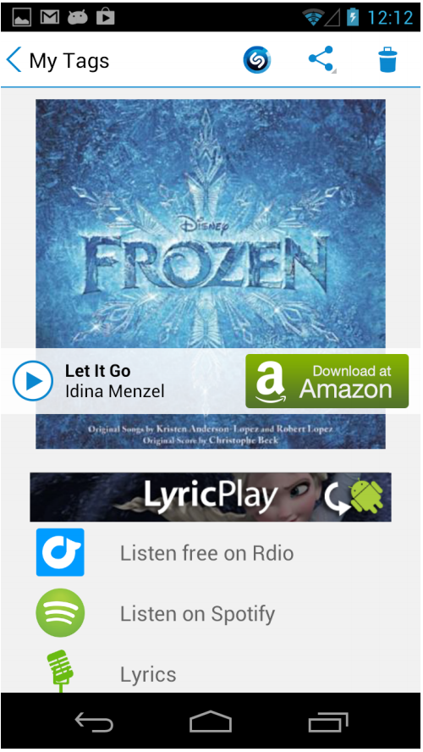
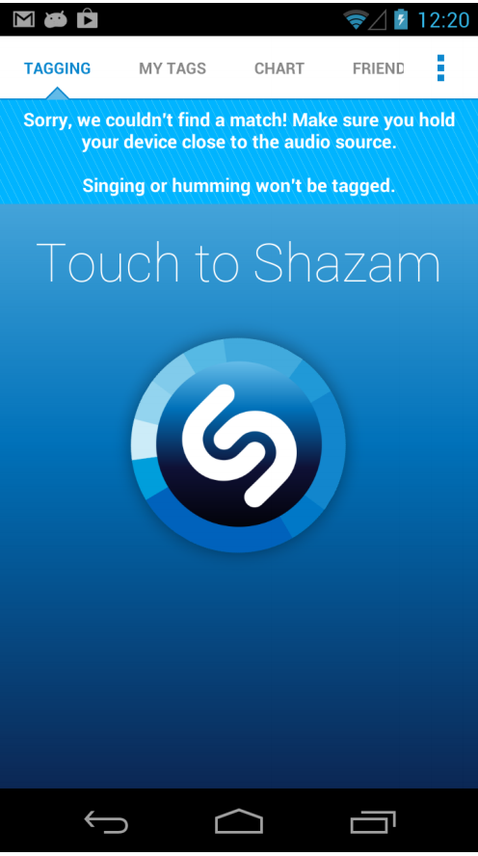
Audio SSDA
Add background noise
Change sample rate

Slide 11
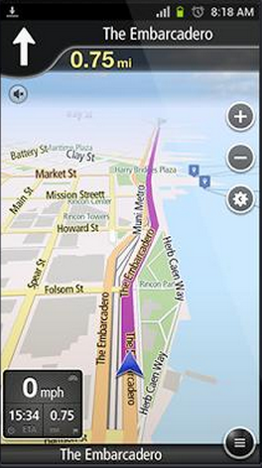
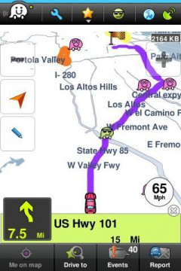


Cross-App Testing
Collect a trace on one app (source) and replaying snippets of it in another app (destination)

Slide 12
Cross-App Testing Evaluation
Sensor | Recording App | Replaying App
GPS | NavFreeUSA | GPS Navigation & Maps Sygic GPS Waze Social GPS Maps Scout GPS Navigation Route 66 Maps
Camera(Frame buffer) | Barcode Scanner | QR Droid RedLaser Barcode Google Goggles Amazon Mobile Walmart
Camera(take picture) | CamCard HD Free | CardToContact Business Card Reader Lite ScanBizCards Lite Google Goggles
Audio | PCM Recorder | Shazam

Slide 13
Conclusion
Problems
Smartphone apps are sensor-driven
Manual testing has low coverage. Automatic test case generation techniques needed to increase coverage
Waste effort to generate test cases for similar feature across apps
Our solution:
Semantic sensor data alteration to explore more paths hence increase coverage
Cross-app testing to reduce the effort of testing similar apps

Slide 14
Thank You & Questions

